Slide 1

Medicinal plants
Some ethnies still use them exclusively
But some of them are forbidden in a lot of country

Slide 2

What are drugs ?
What are drugs in general ?
Any substance that causes a physiological change in the body and can cause addiction
What are drugs in medicine ?
A chemical substance used to treat, cure, prevent, or diagnose a disease

Slide 3

Pharmaceutical drugs
Used for a limited duration
Used on a regular basis for some chronic disorders
Classified into drug classes
We know most of their effects, even side ones

Slide 4
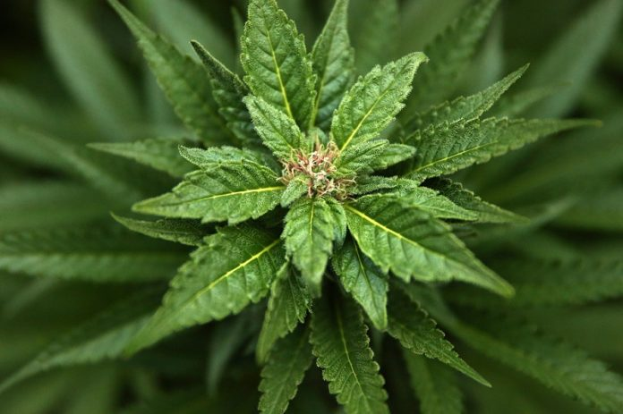
What is marijuana and why do people use it ?
Dried leaves
Flowering on top
Can be smoked in cigarettes
Contains THC
Main goal of users :
Get relax

Slide 5
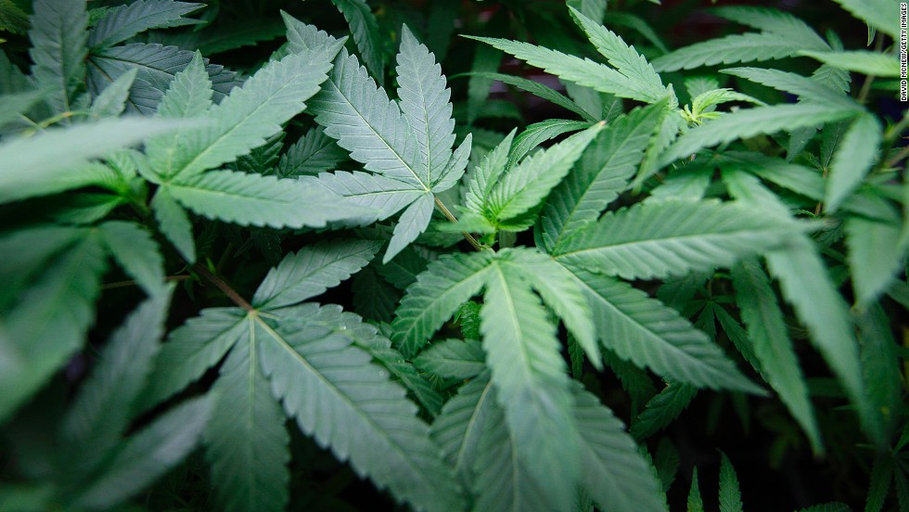
How marijuana can cure diseases, and what are the limits of its use?

Slide 6

I. History of marijuana in medicinal plants
Mentionned in some antique texts chinese and indians, including in Shen nung pen Ts’ao king
Rediscovery by the Occident by Sir William Brooke O’Shaughnessy,
Romans
Today, most cultivated plant in the world
Japan
Greeks
China
Indians
Antique Egypt
Perse
Middle Eastern
1831, The Lancet, publishes its method of injection so as to cure cholera

Slide 7


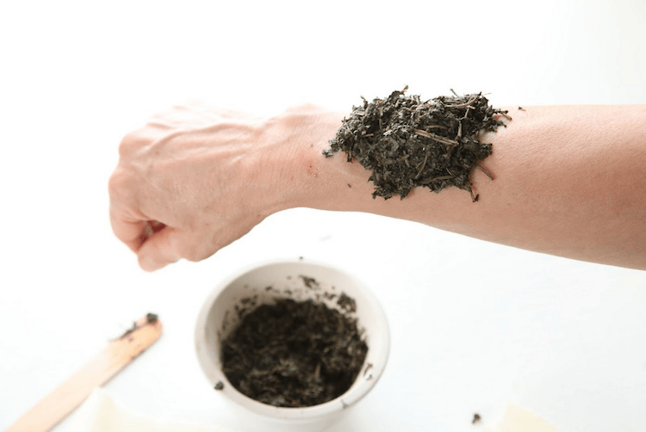
I. History of marijuana in medicinal plants
Tincture
Poultices
Teas

Slide 8
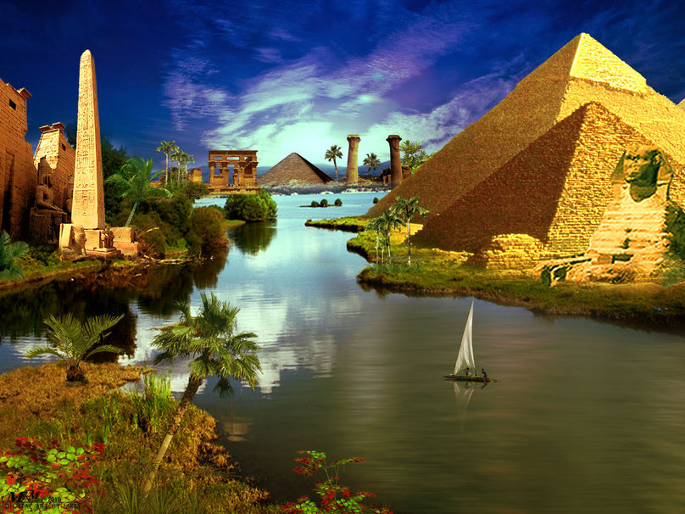
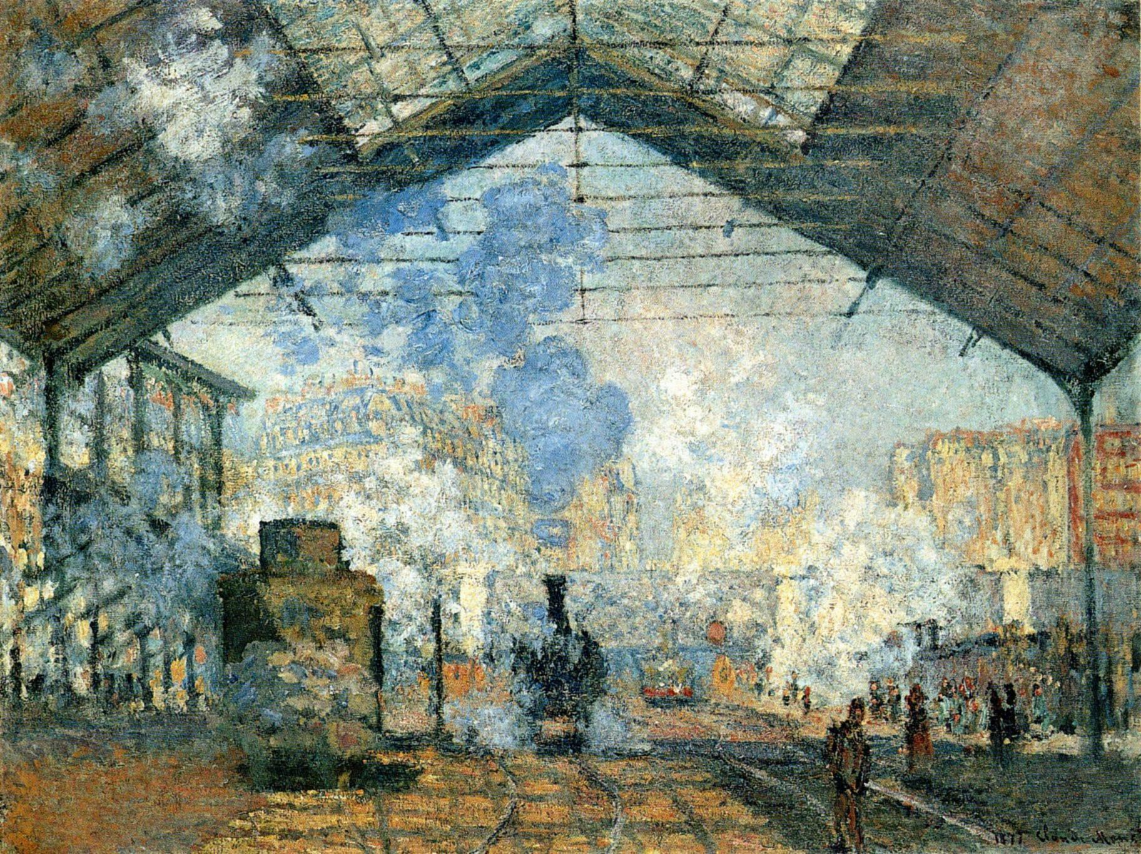
Marijuana = indian hemp
I. History of marijuana in medicinal plants
Antique Egypt
20th century

Slide 9
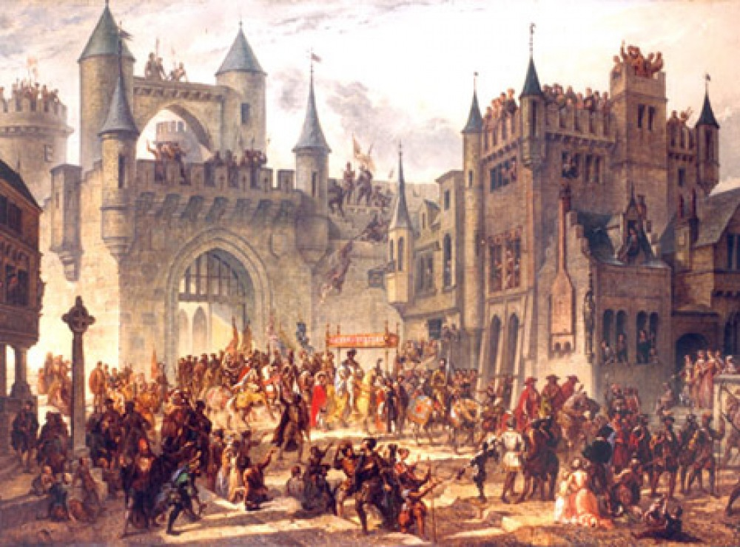
Middle Age
Cannabis consumers = satanists
Since 1950’s
cannabis considered as bad for health

Slide 10
II. What and how it could cure actual diseases
Medical marijuana, a muscle relaxer
It can cure depressions or stress
It can cure sclerosis
It can enhance sleep and change your mood in the mording
Medical marijuana can dilated you vessels
This property allows to prevent glaucoma
It can be used in heart diseases
The creation of a new drug
Dronabinal is a drug made from synthetic THC
It helps people diagnosed with anorexia, Alzheimer's disease or HIV
It helps people suffering from cancer

Slide 11
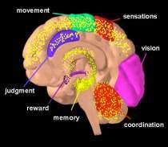
III. Side effects
How does marijuana affect the brain?
THC acts on specific brain cell receptors.
Overactivates parts of the brain that contain the highest number of these receptors

Slide 12
Short-Term Effects
Altered senses
Altered sens of time
Changes in mood
Impaired body movement
Difficulty with thinking and problem-solving
Impaired memory

Slide 13
Long-Term Effects
Reduces thinking, memory, learning functions
Affects on how the brain builds connections between the areas necessary for these functions

Slide 14
Research
Study from New Zealand
Lost mental ability: -8 IQ points between 13 and 38

Slide 15
Health Effects: Physical Effects
Breathing problems (irritates lungs, cough, phlegm, lung illness/infection, lung cancer)
Increased heart rate (raises heart rate for up to 3h after smoking, heart attack)
Problem with child development during and after pregnancy (lower birth weight, brain and behavioral problems, breast milk)

Slide 16
Mental Effects
Temporary hallucinations (fake sensations and images)
Temporary paranoia (distrust of others)
Worsening symptoms (in patients with schizophrenia)
Mental heatlh problems (depression, anxiety, suicidal thoughts)

Slide 17
How does marijuana affect a person’s life?
Lower life satisfaction
Poorer mental health
Poorer physical health
More relationship problems
Less academic and career success
job absences, accidents, injuries
Dropping out of school

Slide 18
Can marijuana lead to substance use disorder and addiction?
It can lead to the development of problem use=substance use disorder=30 %
and in severe cases to addiction

Slide 19
Withdrawal symptoms that make quitting difficult
Grouchiness
Sleeplessness
Decreased apetite
Anxiety
Cravings

Slide 20
Conclusion

