Slide 1

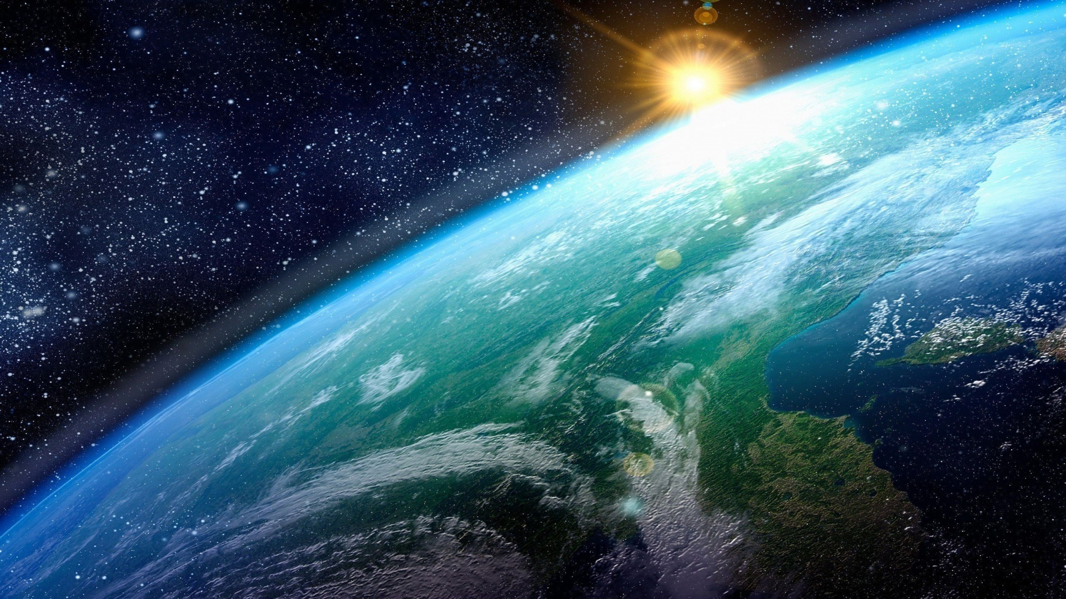

Life beyond Earth
Since the apparition of Life
to the research of Exoplanets

Slide 2
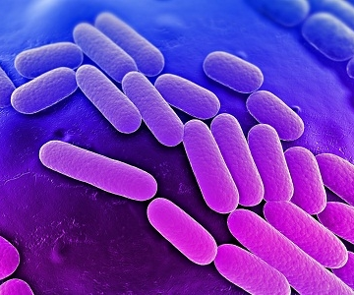
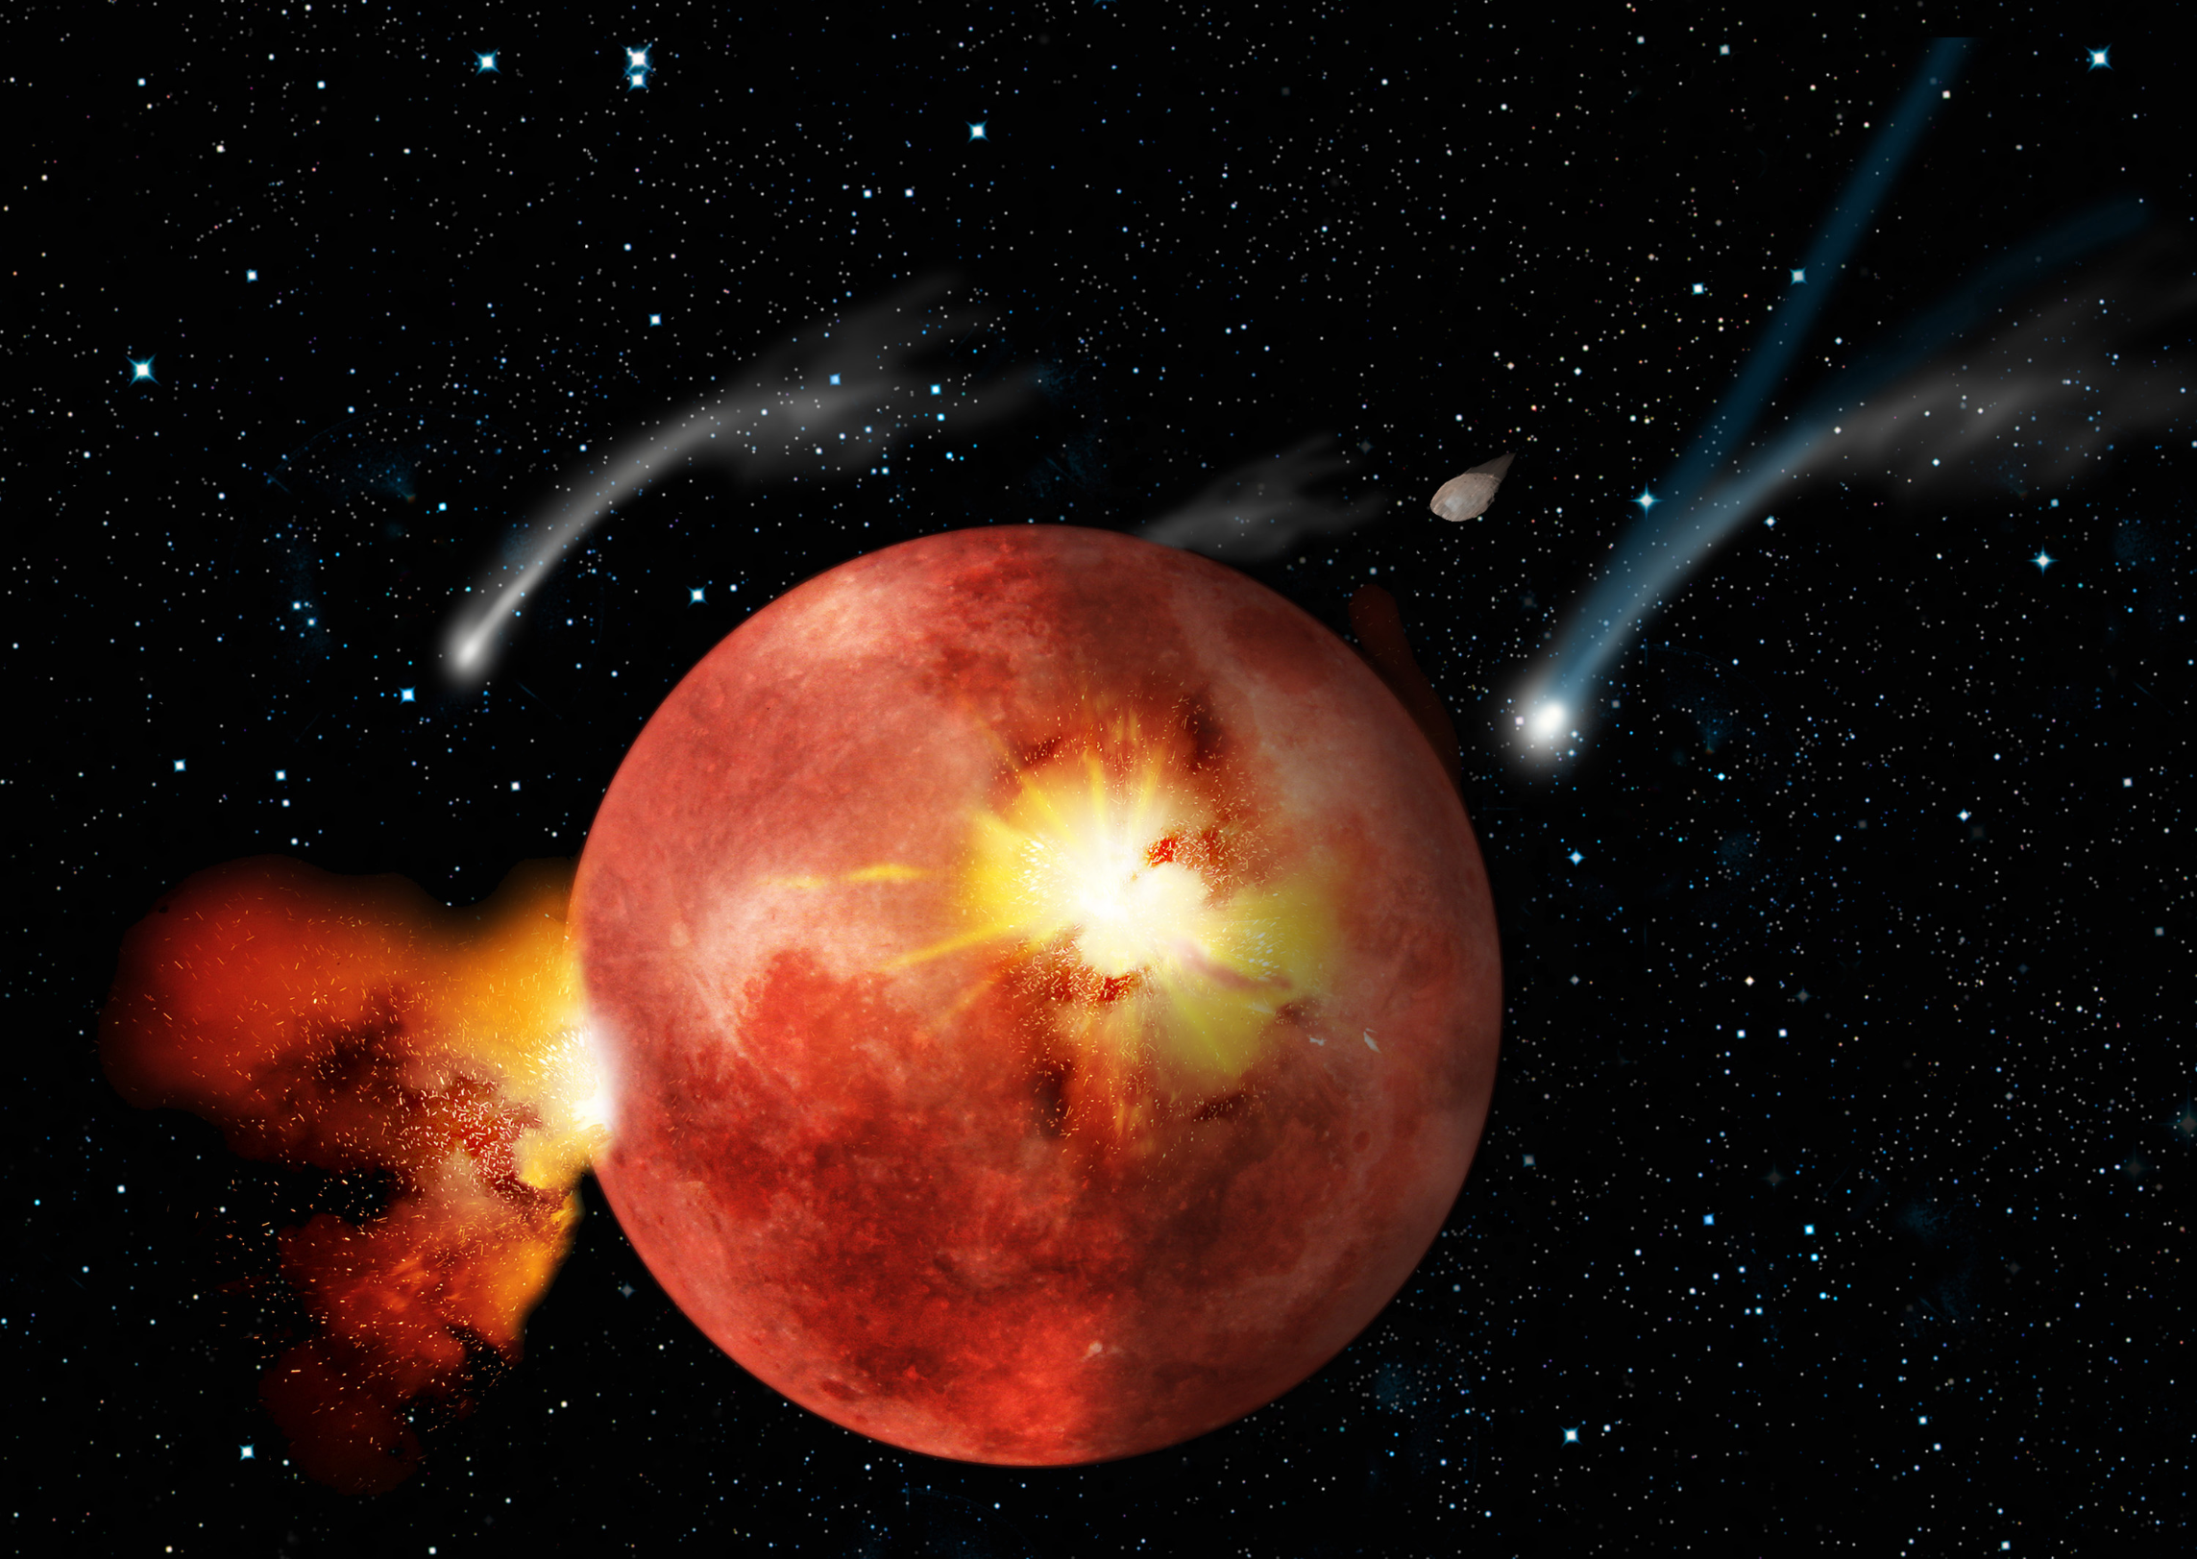
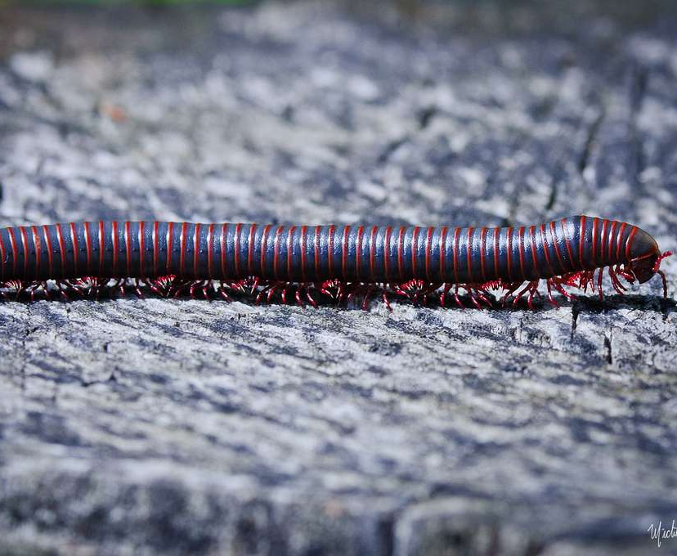
I. The origins of life
A) On our Earth
- Age > 4. 5 billion years old
-Life appears > 1 billion years later
-Single-celled prokaryotic cells*
Def°
Unicellular organism that lacks a membrane- bound nucleus. In Greek 'pro' before / 'karyon' nucleus

Slide 3
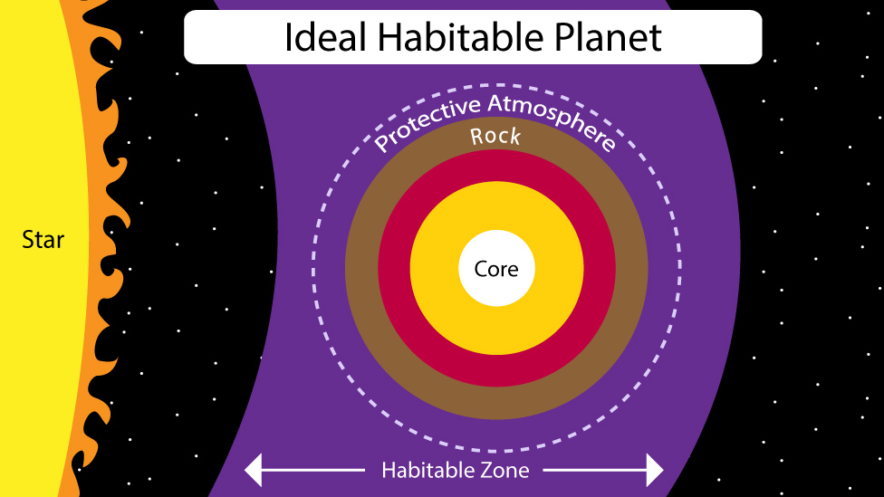
B) What conditions ARE REQUIRED FOR life and its development ?
From a chemical point of view

Slide 4
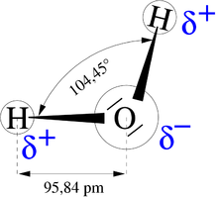
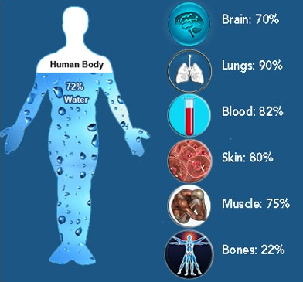
1°) wATER
chemical formula H2O
3 states: solid, liquid and gas.
solid and gaseous forms are not
conducive to the development of life
Fundamental properties ​
> facilitates chemical reactions without interacting directly > Catalyst ​
+ "universal solvent" ​

Slide 5
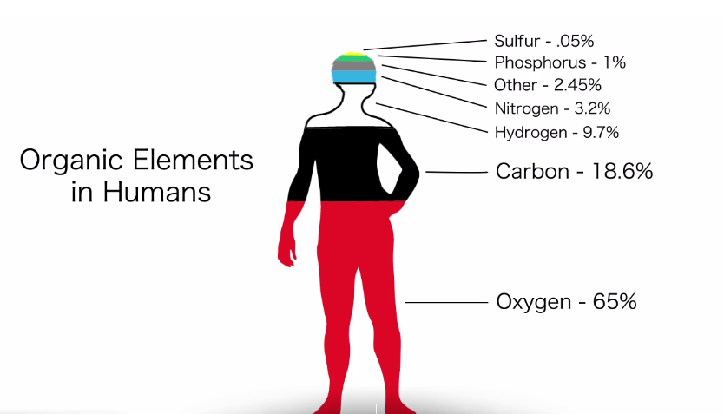
2 ) Oxygen & dioxygen
- colorless, odorless and tasteless gas.
-It is produced by plants containing chlorophyll
-atmospheric air contains about 20% of oxygen.
- the anaerobes: bacteria able to live without oxygen
-The terrestrial oxygen is produced by plant photosynthesis (the Taiga).

Slide 6
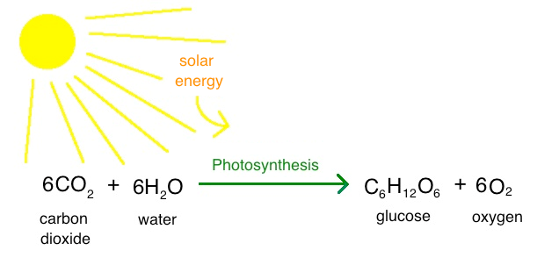
3) The ground
- important for 2 reasons
> support on which plants grow
4) Light and photosynthesis
- Light = basis of photosynthesis = source of the entire chain of evolution.
- Plants and animals absorb oxygen and release carbon dioxide (CO2) > "breathing".

Slide 7
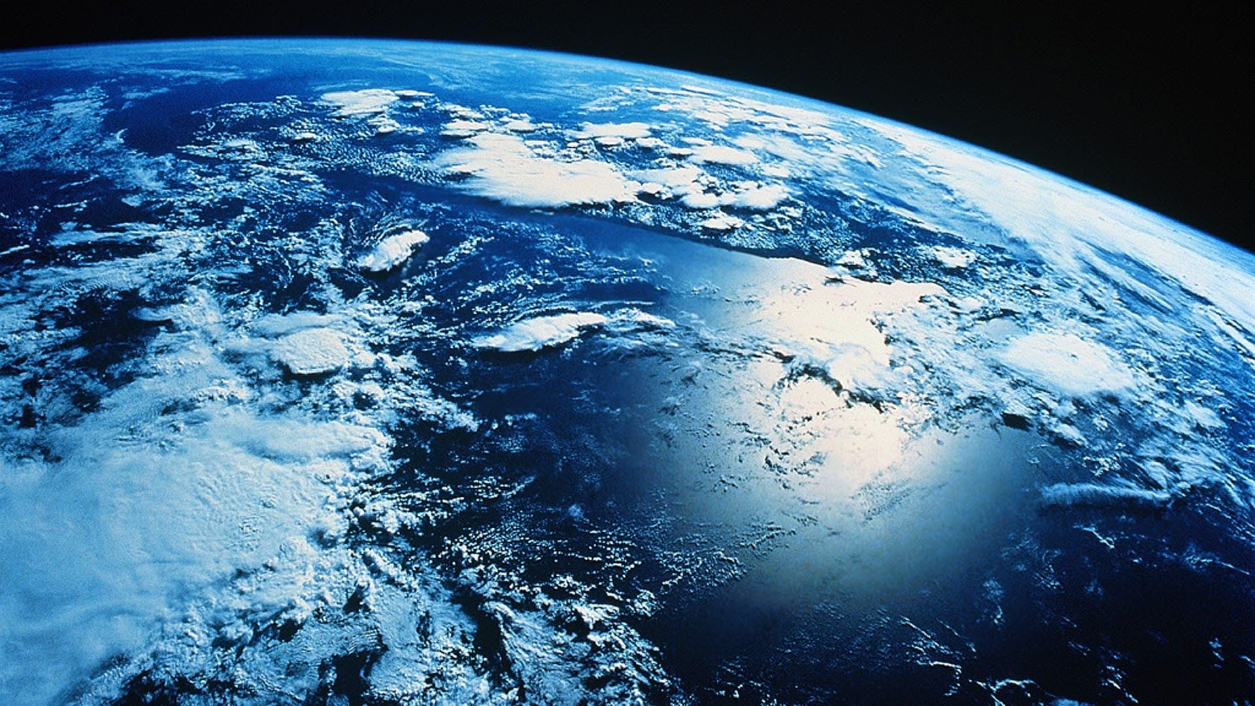
II. ALL ABOUT EXOPLANETS
What is a planet ?
Come from the latin word which mean "moving faster"
Astronomical body orbiting a star
Rounded by it's own gravity
Minimal size:
5 x 10^20 kg
800km of diameter
8 planets in the solar system: Mercure, Venus, la Terre, Mars, Jupiter, Saturn, Uranus et Neptune.

Slide 8
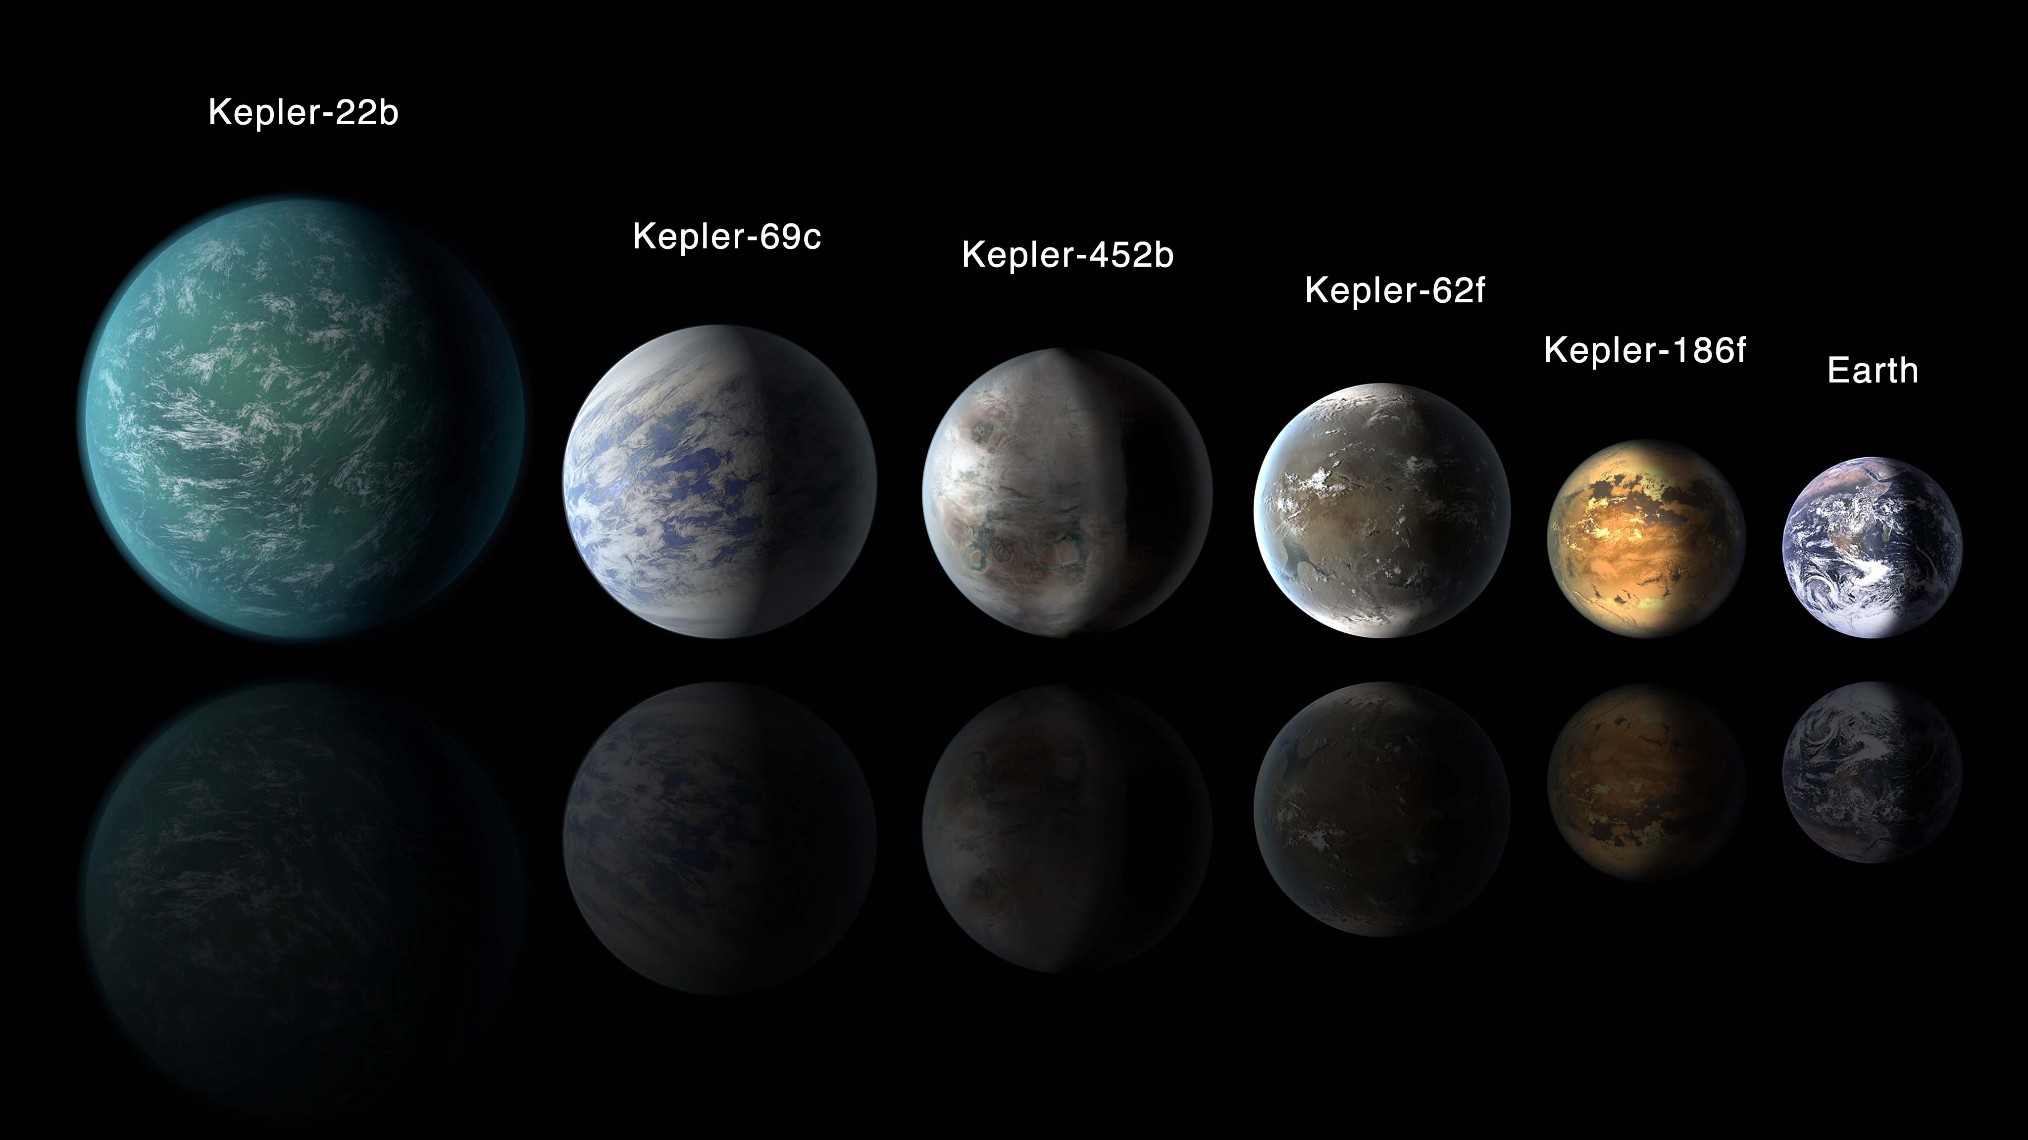
EXOPLANETS
IT'S A TYPE OF PLANET ORBITING A DIFFERENT STARS FROM THE SUN
Giordano Bruno says : "fixed stars are similar to the Sun – so must be accompanied by planets."
FIRST DISCOVERY :
51 Pegasi b. bye two Swiss astronomers, Didier Queloz and Michel Mayor in 1955
3,608 exoplanets, in 2,702 planetary systems and 610 multiple planetary systems

Slide 9
CAN WE REACH PROXIMA B ?
The spaceship Saturn V, which has been used during Apollo 11, can travel at 9600km/h. It’s 4,5 times faster than the Concorde. The closest exoplanet is 4.2 light years from here. One light year is equivalent to 9461 billion of km:
V= D/T T= D/V
T= (4,2 x 9461 x 10⁹) / 9600
T= 4139187500 h
T= 172466145.8 days
T= 472510 years

Slide 10
CAN WE REACH PROXIMA B ? ​
Every years, the speed of the space-ship are improved. Let's us considered that the speed is increased by 5% every years.
Let's U be a geometric sequence and n the years:
U_{n}=U x (1+0.05)^{n}
V_{light}=U x (1+0.05)^{n}
300 000 = 3 x 1,05^{n}
100 000 = 1.05^{n}
N = 236

Slide 11
Iii. How to find EXOPLANETS
The first scientific detection of an exoplanet was in 1988. However, the first confirmed detection came in 1992, since then, there have been 3,608 exoplanets confirmed detections.
Link video : https://www.youtube.com/watch?v=AnX7ExBjrHw
Methods :
Direct Imaging
Transit Method
Radial Velocity wiggles
Link animation : https://exoplanets.nasa.gov/interactable/11/

Slide 12
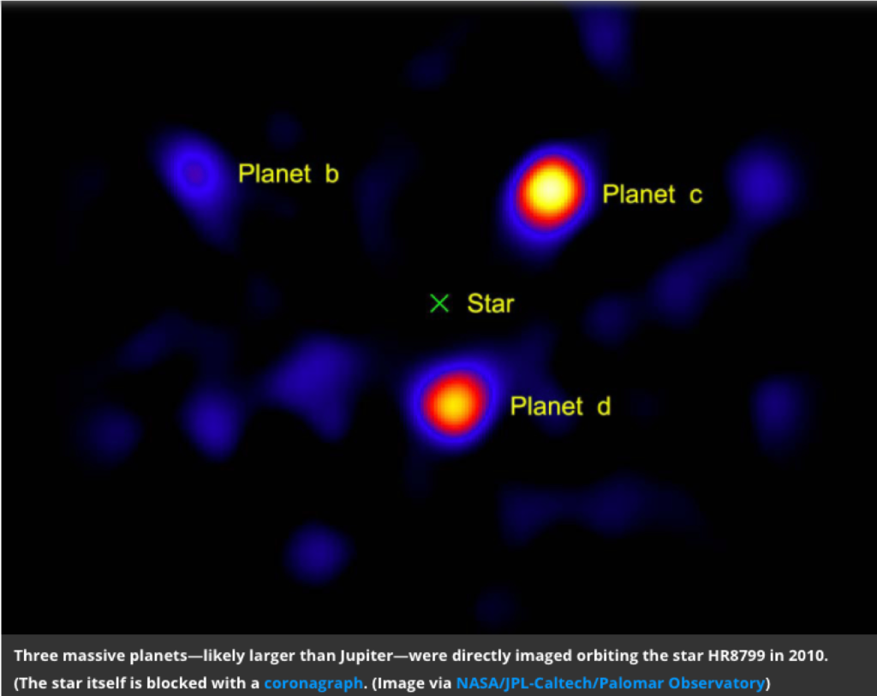
1) Direct IMAGING
10 times the size of Jupiter (69 911km) and orbit at least as big

Slide 13
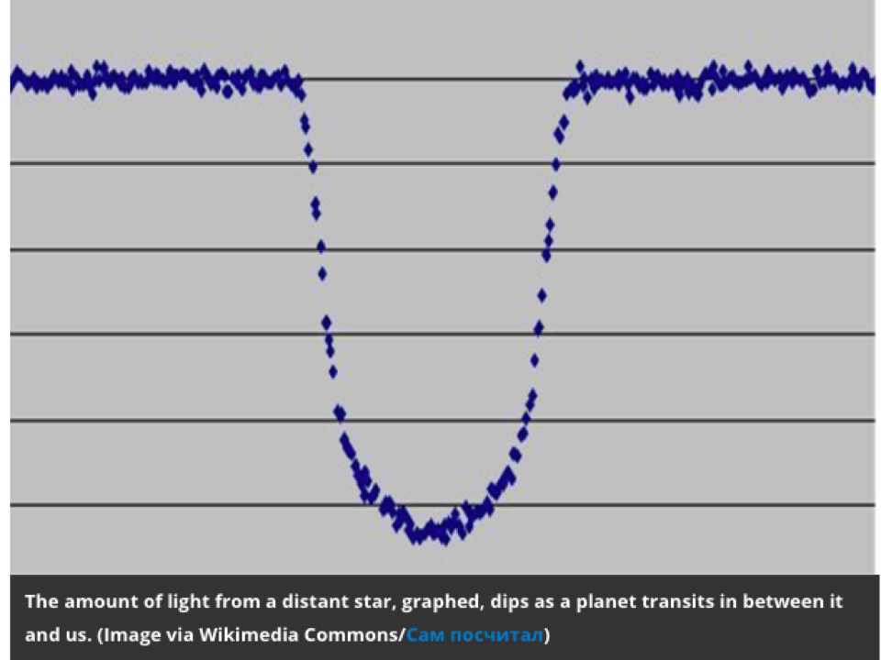
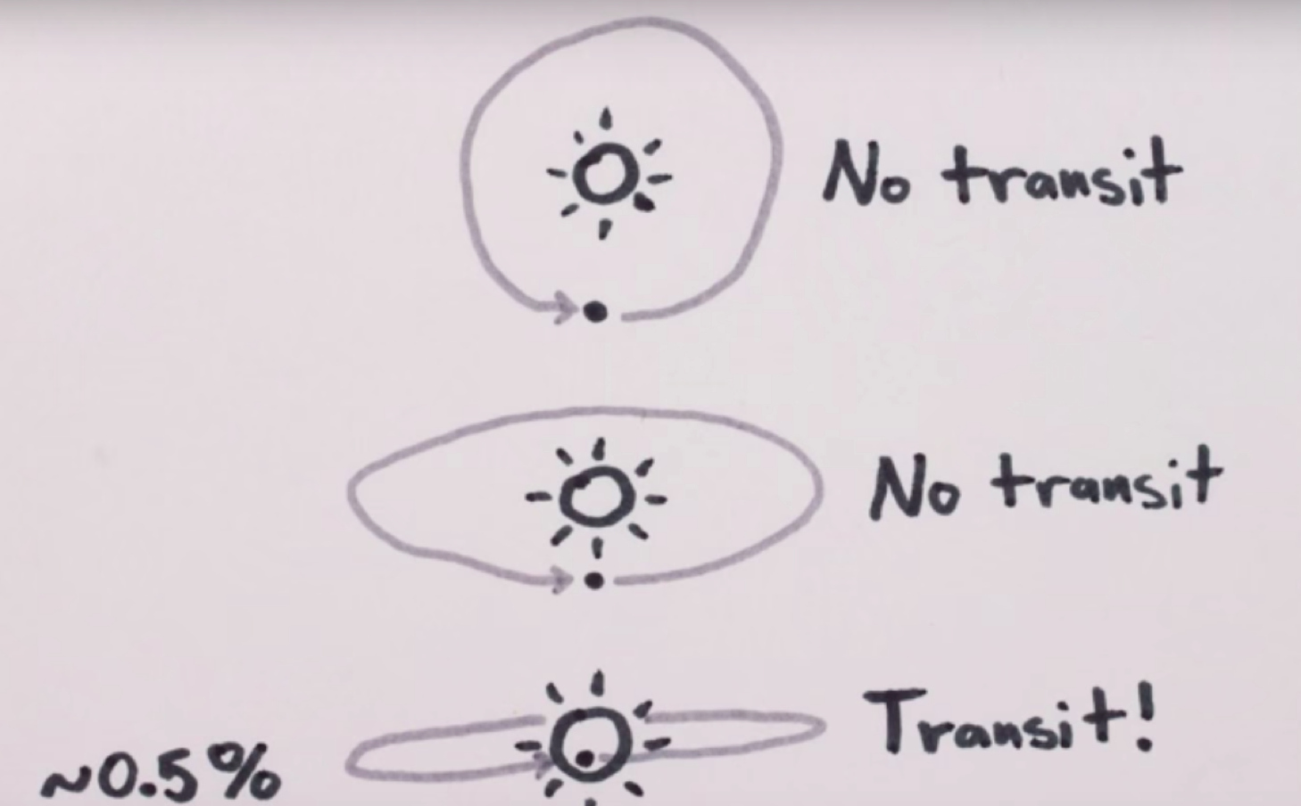
2) the Transit method
Photometric effect to be measured, a transit must occur : 1%

Slide 14
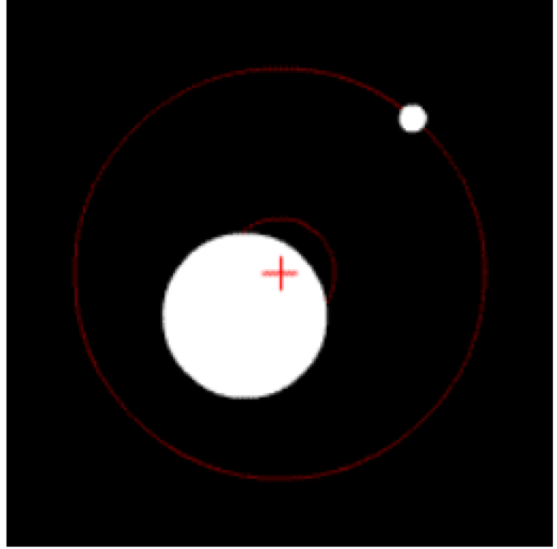
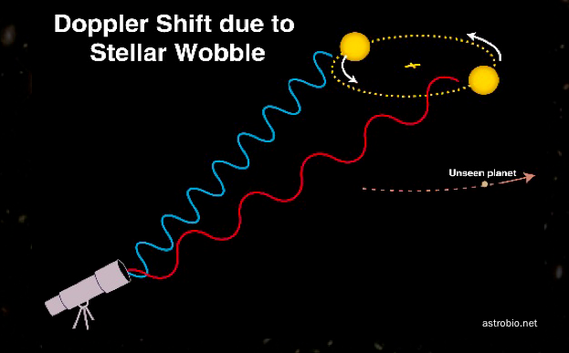
3) the radial velocity wiggle
The motion manifests itself as a tiny wobble in the velocity of the star relative to us
Measure the red or blue Doppler shift of the star light.

Slide 15
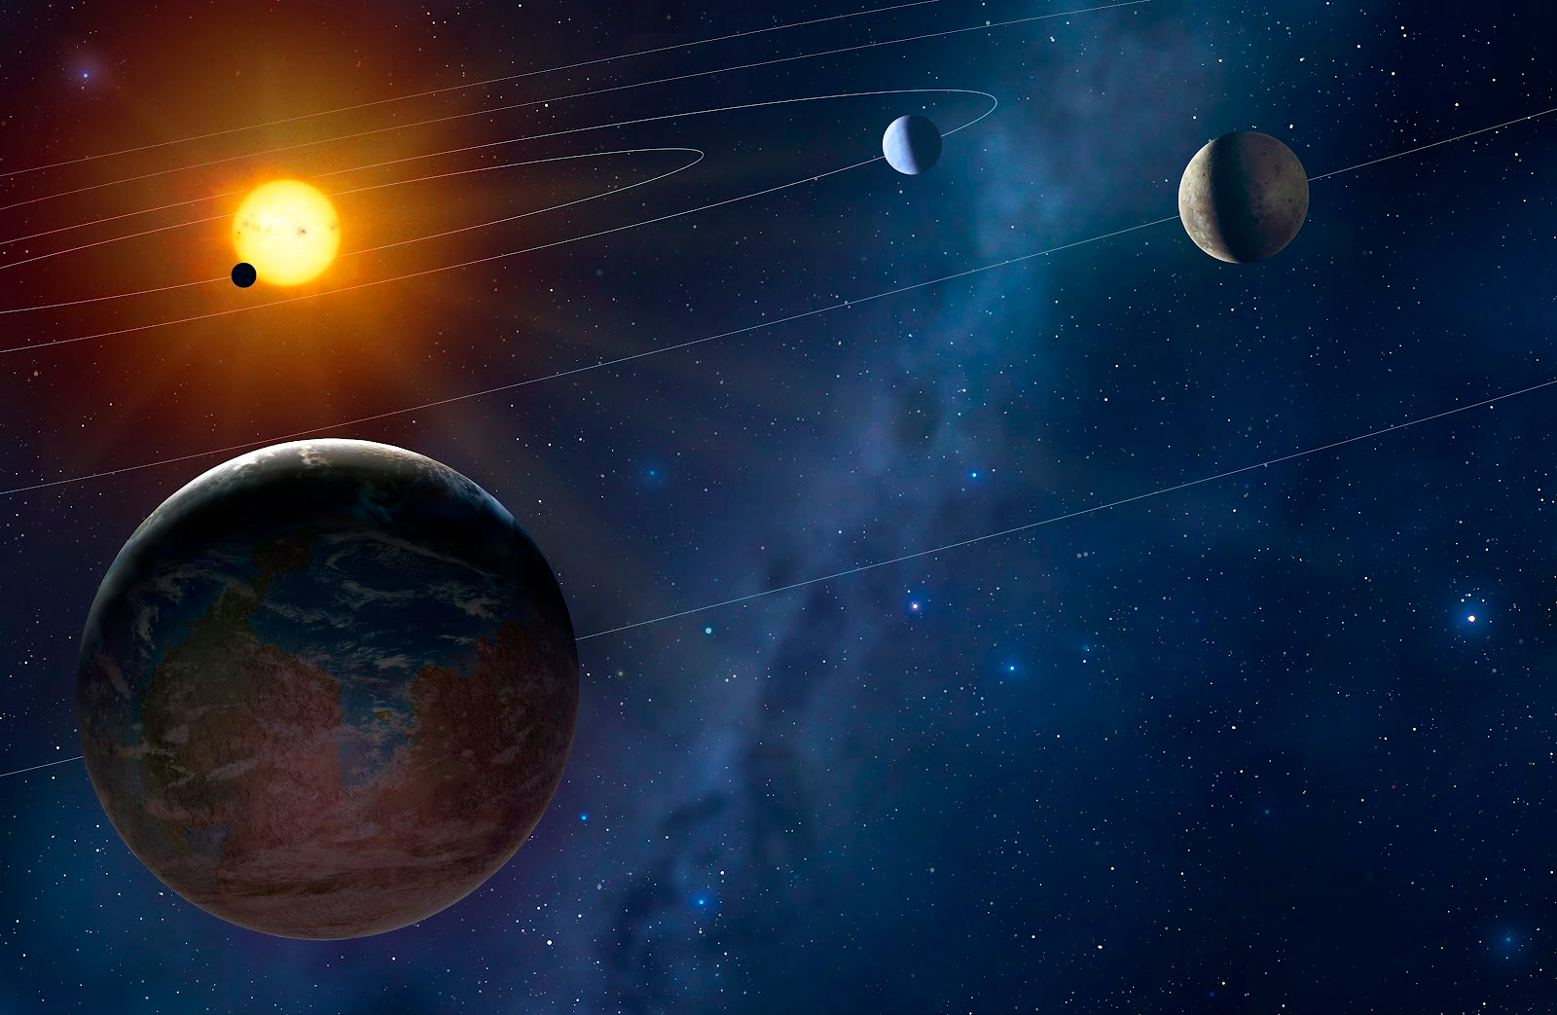
How many exoplanets have been found thanks to these methods ?
Direct Imaging : 44
The transit method : 2729
Radial velocity wiggle : 632
Others methods exist to find exoplanet

Slide 16
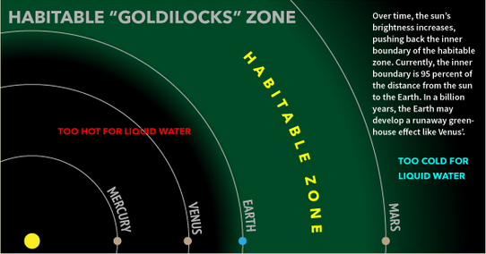
IV. Is iT REALISTIC TO LIVE ON AN EXOPLANET?

Slide 17
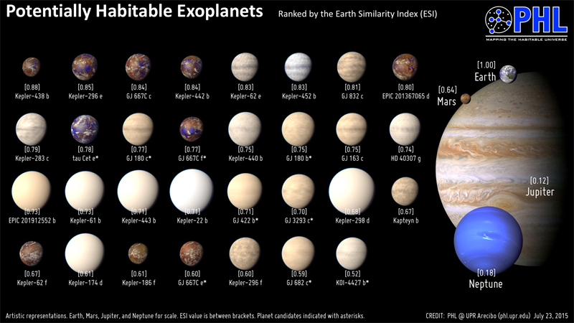
V. CONCLUSION

Slide 18


NASA Wants To Seed Exoplanets With Human DNA

Slide 19
Thank you for your attention!

Slide 20
YOU want to increase you knowledge about exoplanets ? visit our websites (sitography)
https://www.nasa.gov/mission_pages/kepler/main/index.html
http://exoplanet.eu/
https://exoplanetarchive.ipac.caltech.edu/
http://www.mirror.co.uk/science/what-exoplanet-heres-what-you-9902309
http://phl.upr.edu/projects/habitable-exoplanets-catalog
http://www.space.com/24903-kepler-space-telescope.html
http://planets.ucla.edu/research/research-areas/origins-of-life/
http://learn.genetics.utah.edu/content/astrobiology/conditions/

